Slide 1
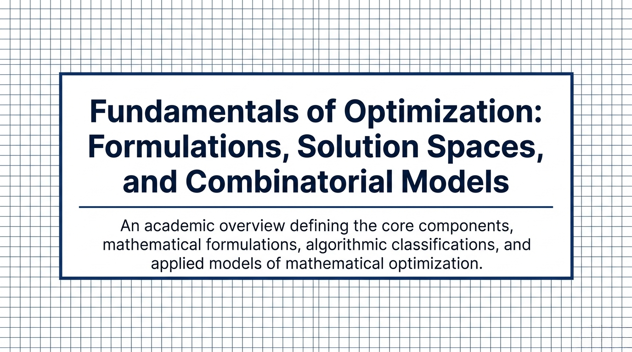
Notes:
Slide 1 (Title Slide) "Welcome to this presentation on the Fundamentals of Optimization. Today, we will provide an academic overview defining the core components, mathematical formulations, algorithmic classifications, and applied models of mathematical optimization."

Slide 2
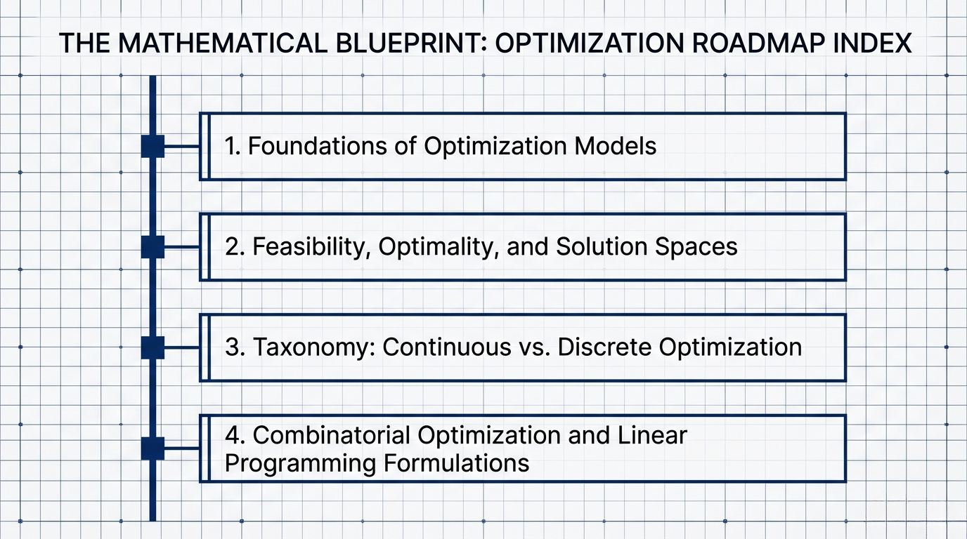
Notes:
Slides 2 & 3 (The Mathematical Blueprint & Motivation) "Our roadmap for today is divided into four main sections: Foundations of Optimization Models, Feasibility and Solution Spaces, Taxonomy of Continuous versus Discrete Optimization, and Combinatorial Optimization Formulations. Our primary motivation for the first section is that to formulate mathematical solutions, we must first define the universal components that constitute any optimization problem."

Slide 3
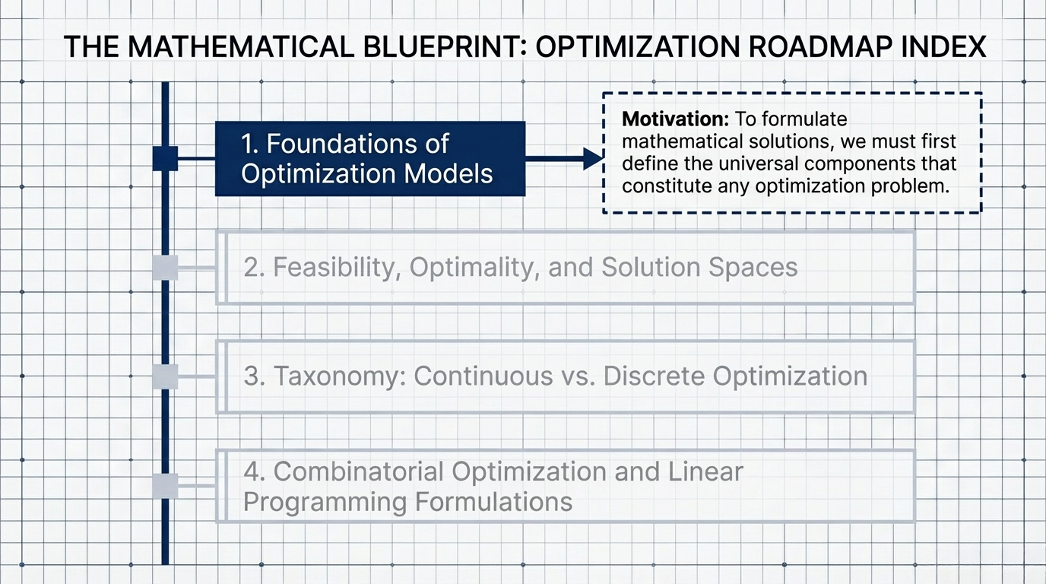
Notes:
Slides 2 & 3 (The Mathematical Blueprint & Motivation) "Our roadmap for today is divided into four main sections: Foundations of Optimization Models, Feasibility and Solution Spaces, Taxonomy of Continuous versus Discrete Optimization, and Combinatorial Optimization Formulations. Our primary motivation for the first section is that to formulate mathematical solutions, we must first define the universal components that constitute any optimization problem."

Slide 4
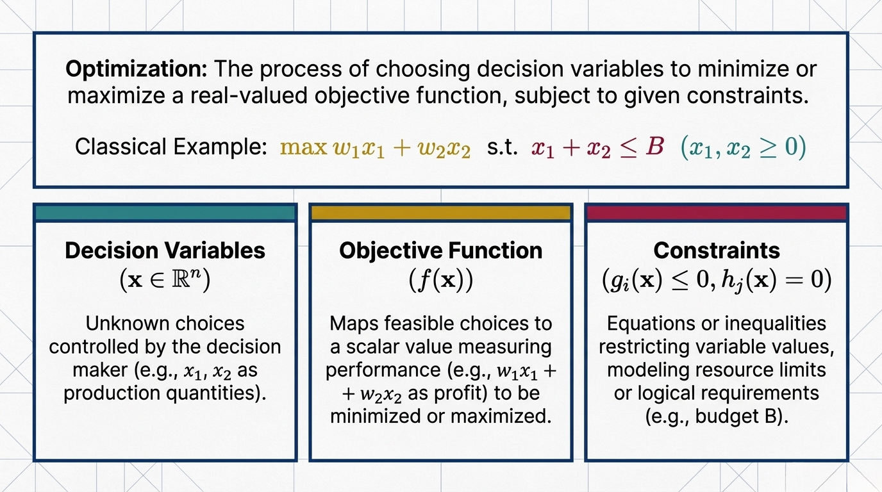
Notes:
Slide 4 (Optimization Definition & Components) :Finding the best possible solution among many possible choices. Or mathematically talking: "At its core, optimization is the process of choosing decision variables to minimize or maximize a real-valued objective function, subject to given constraints. The three pillars of this process are: Decision Variables, which are the unknown choices we control; the Objective Function, which maps our choices to a scalar value measuring performance; and Constraints, which are equations or inequalities restricting variable values due to resource limits or logical requirements

Slide 5
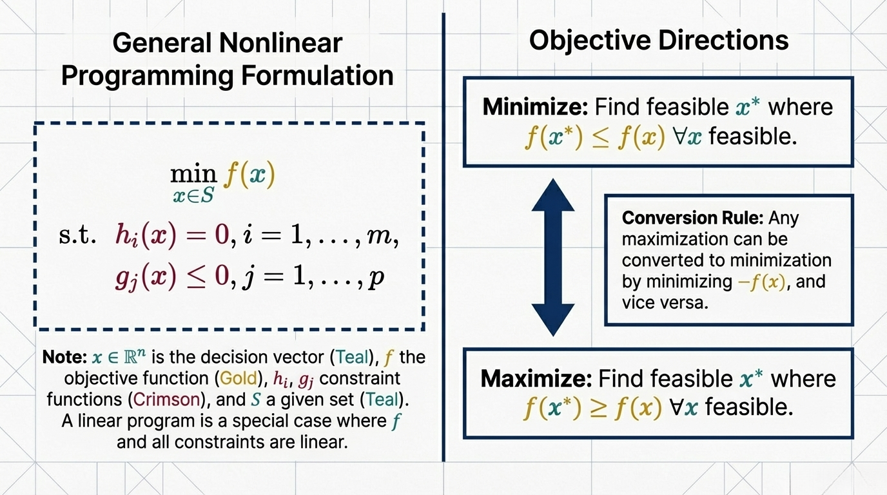
Notes:
Slide 5 (General Nonlinear Programming Formulation) "Mathematically, a General Nonlinear Programming formulation seeks to find a decision vector 'x' within a given set that minimizes an objective function, subject to equality and inequality constraints. It is important to note the conversion rule: any maximization problem can be converted to a minimization problem by simply minimizing the negative of the objective function, and vice versa."

Slide 6
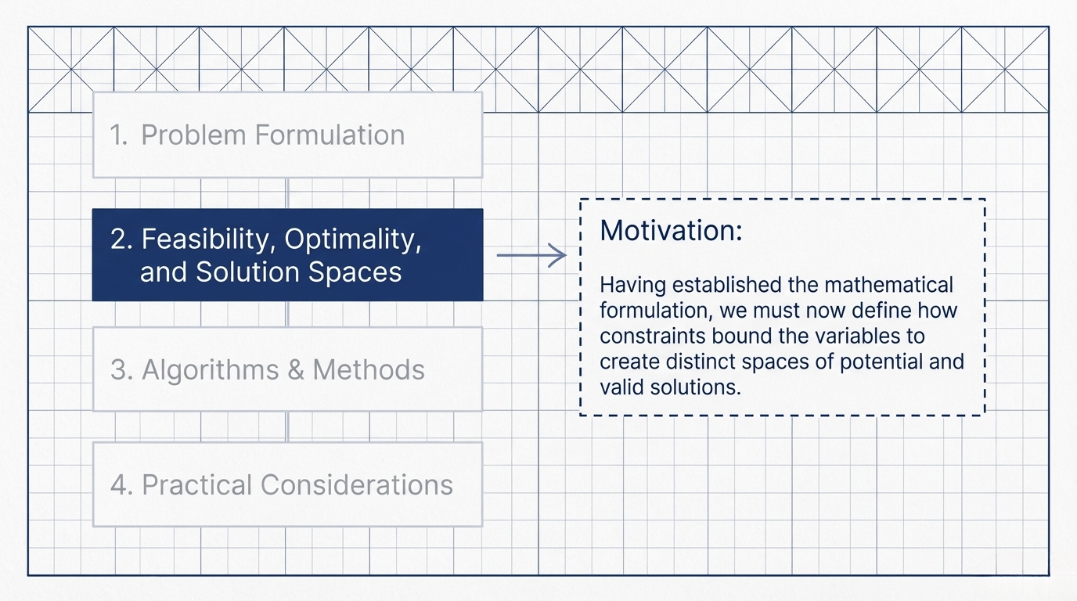
Notes:
Slide 6 (Roadmap: Feasibility, Optimality, and Solution Spaces) "Moving to the second part of our blueprint. Having established the mathematical formulation, our motivation here is to define how constraints bound the variables to create distinct spaces of potential and valid solutions

Slide 7
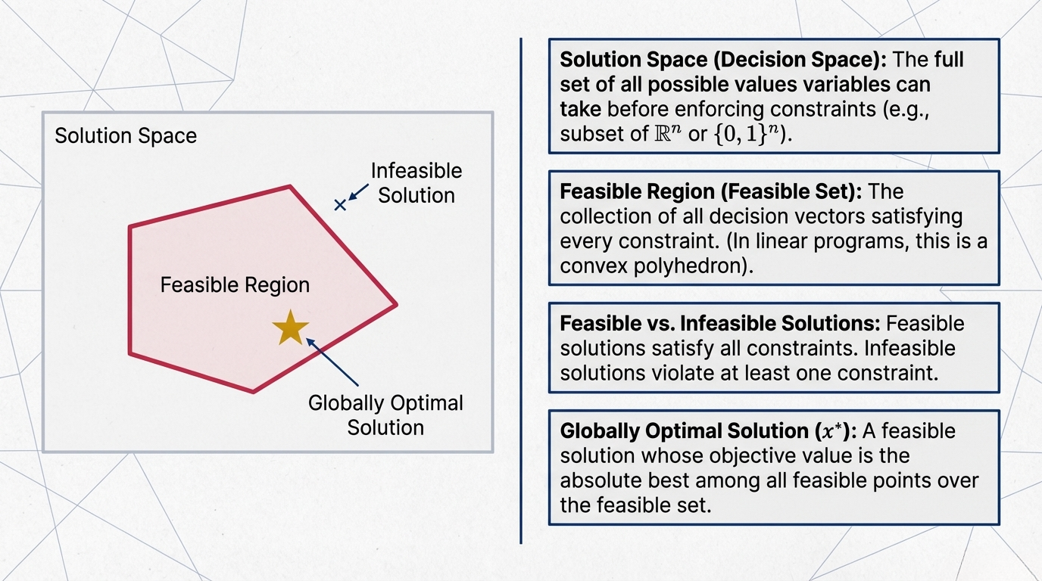
Notes:
Slide 7 (Solution Space vs. Feasible Region) "We must distinguish between different spaces. The 'Solution Space' is the full set of all possible values variables can take before enforcing constraints. The 'Feasible Region' is the collection of all decision vectors satisfying every constraint—often forming a convex polyhedron in linear programs. A solution is 'feasible' if it satisfies all constraints, whereas our ultimate goal is the 'Globally Optimal Solution', which is the absolute best point within the entire feasible set."

Slide 8
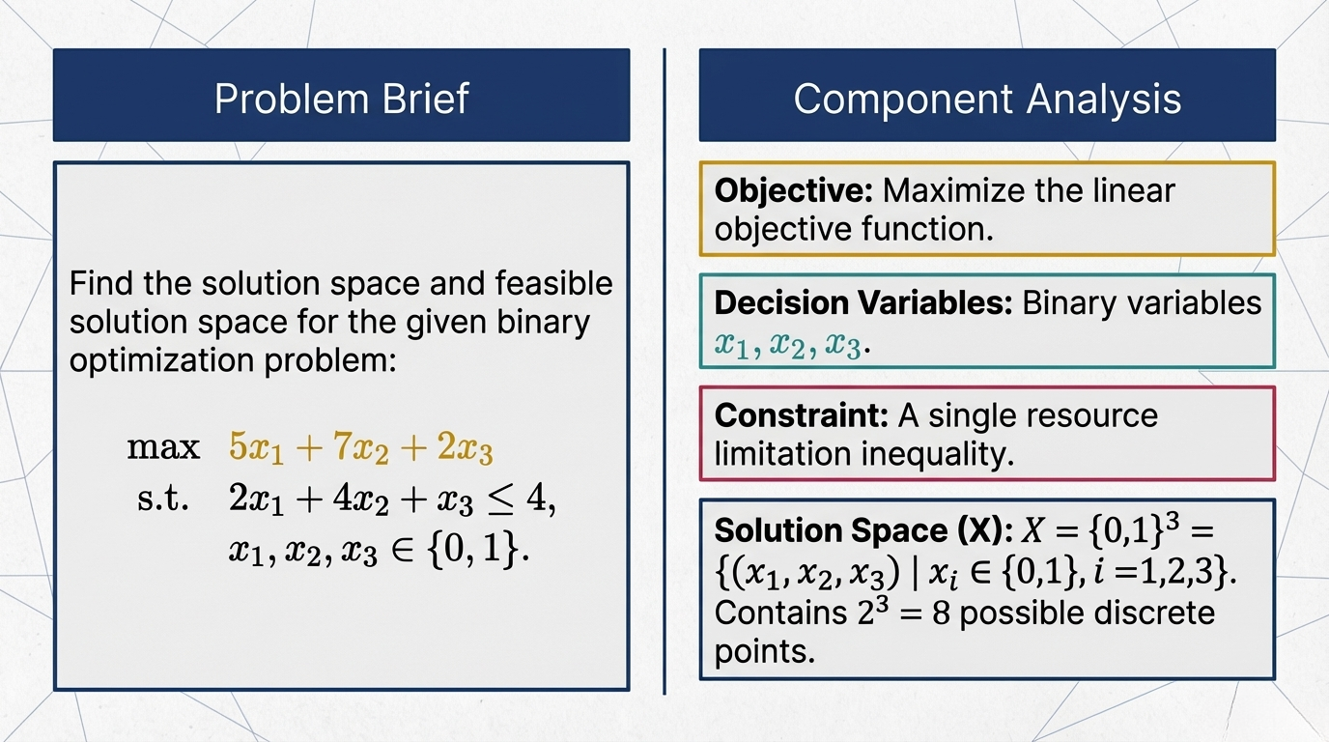
Notes:
Slide 8 (Problem Brief) "Let's look at a component analysis for a binary optimization problem. We want to maximize the objective function 5x1 + 7x2 + 2x3, subject to a single resource limitation inequality, where all three variables are binary. Here, our initial solution space consists of 2 to the power of 3, or 8, possible discrete points."

Slide 9
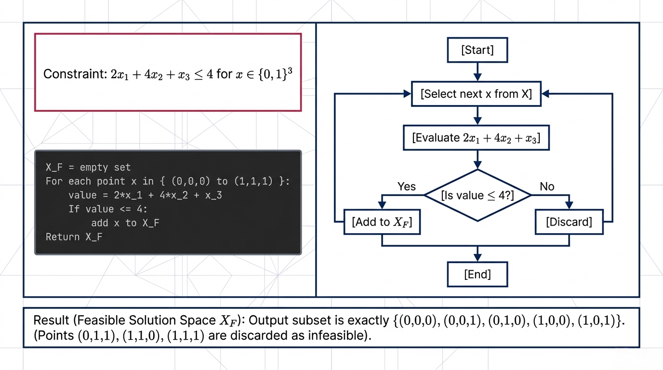
Notes:
Slide 9 (Constraint Evaluation Flowchart) "To find the feasible solution space, we systematically evaluate the constraint for each of the 8 points. As shown in the flowchart, points that yield a value less than or equal to 4 are added to our feasible set, while those exceeding 4 are discarded. The resulting feasible solution space contains exactly 5 valid points."

Slide 10
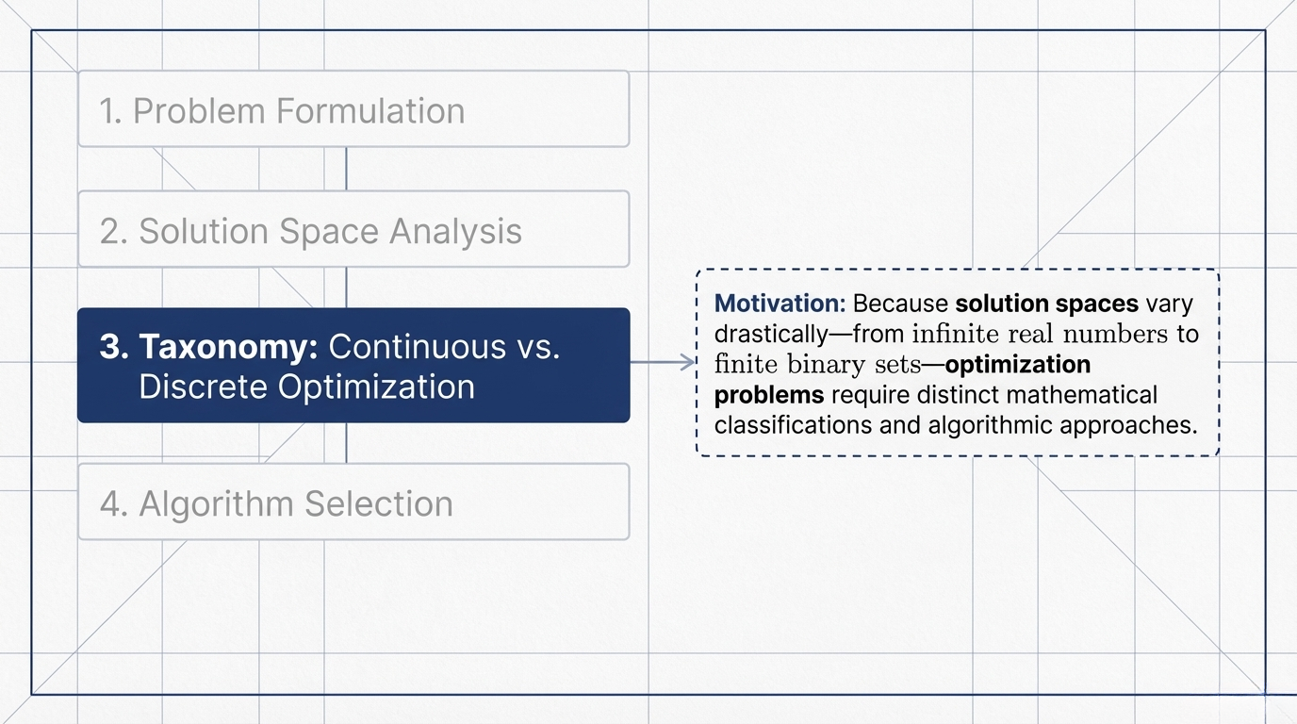
Notes:
Slide 10 (Roadmap: Taxonomy) "Our third section covers the Taxonomy of optimization. Because solution spaces vary drastically—from infinite real numbers to finite binary sets—these problems require distinct mathematical classifications and algorithmic approaches."

Slide 11
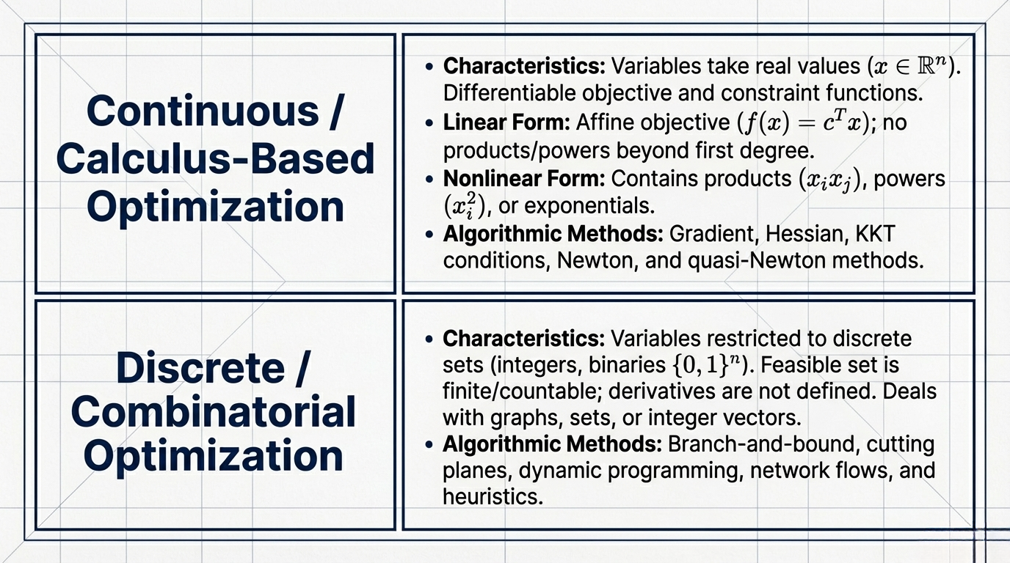
Notes:
Slide 11 (Continuous vs. Discrete Optimization) "In Continuous or Calculus-Based Optimization, variables take real values and functions are differentiable, allowing us to use methods relying on gradients, Hessians, and KKT conditions. In contrast, Discrete or Combinatorial Optimization restricts variables to discrete sets like integers or binaries. Because the feasible set is finite or countable and derivatives are not defined, we must rely on algorithms like branch-and-bound, cutting planes, or dynamic programming."

Slide 12
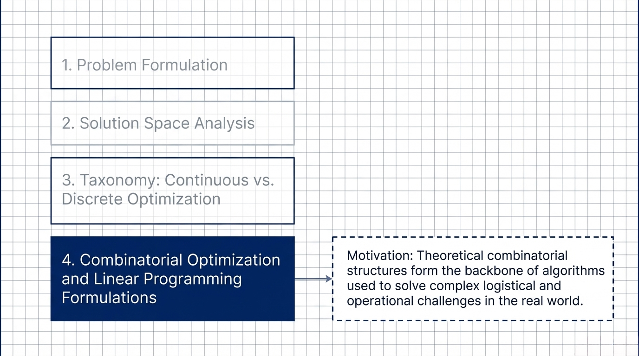
Notes:
Slide 12 (Roadmap: Combinatorial Optimization) "Our final section touches upon Combinatorial Optimization and Linear Programming. The motivation here is that theoretical combinatorial structures form the backbone of the algorithms used to solve complex logistical and operational challenges in the real world."

Slide 13
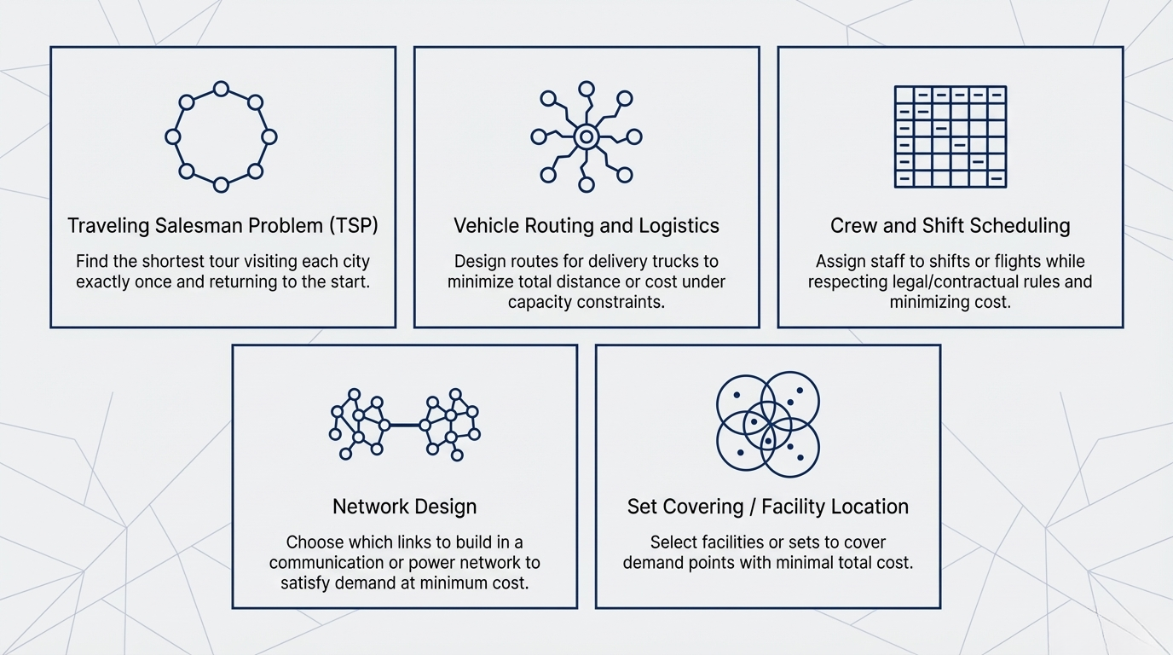
Notes:
Slides 13, 14 & 15 (Synthesis and Conclusion) "To synthesize and conclude our presentation: First, optimization fundamentally relies on defining decision variables, establishing a directional objective function, and delineating a bounded feasible region. Second, the transition from theoretical solution spaces to feasible spaces can be algorithmically evaluated, filtering mathematical possibility into operational reality. Finally, the problem's topology dictates the methodology: continuous formulations utilize calculus-based methods, whereas discrete, combinatorial structures require specialized integer programming to solve complex real-world logistical networks. Thank you."

Slide 14
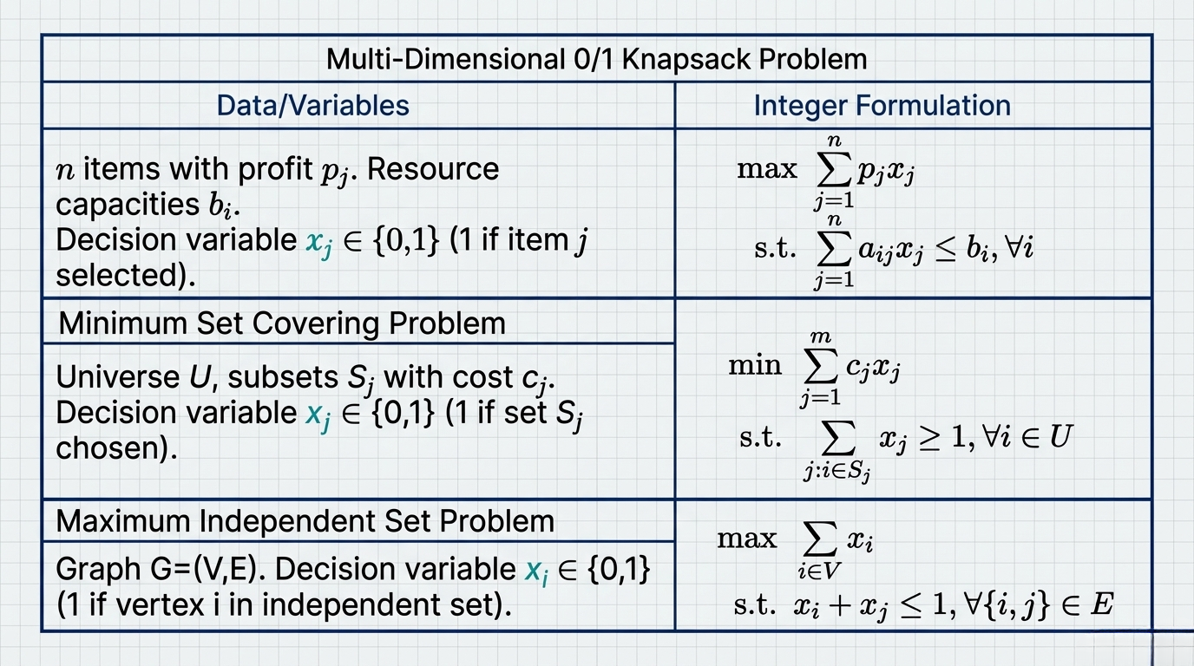
Notes:
Slides 13, 14 & 15 (Synthesis and Conclusion) "To synthesize and conclude our presentation: First, optimization fundamentally relies on defining decision variables, establishing a directional objective function, and delineating a bounded feasible region. Second, the transition from theoretical solution spaces to feasible spaces can be algorithmically evaluated, filtering mathematical possibility into operational reality. Finally, the problem's topology dictates the methodology: continuous formulations utilize calculus-based methods, whereas discrete, combinatorial structures require specialized integer programming to solve complex real-world logistical networks. Thank you."

Slide 15
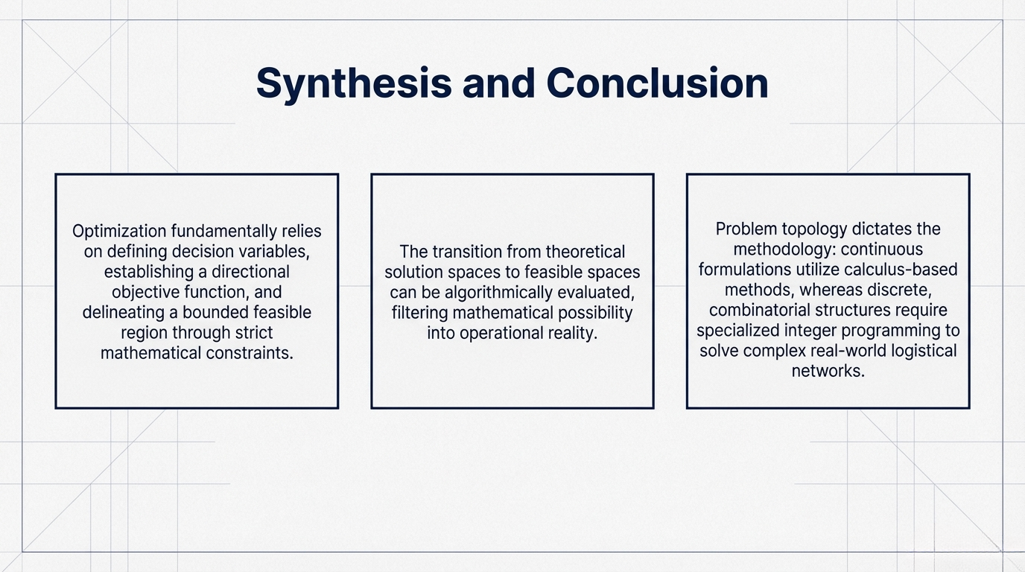
Notes:
Slides 13, 14 & 15 (Synthesis and Conclusion) "To synthesize and conclude our presentation: First, optimization fundamentally relies on defining decision variables, establishing a directional objective function, and delineating a bounded feasible region. Second, the transition from theoretical solution spaces to feasible spaces can be algorithmically evaluated, filtering mathematical possibility into operational reality. Finally, the problem's topology dictates the methodology: continuous formulations utilize calculus-based methods, whereas discrete, combinatorial structures require specialized integer programming to solve complex real-world logistical networks. Thank you."

